Slide 1
Computer Systems
Unit # 1

Slide 2
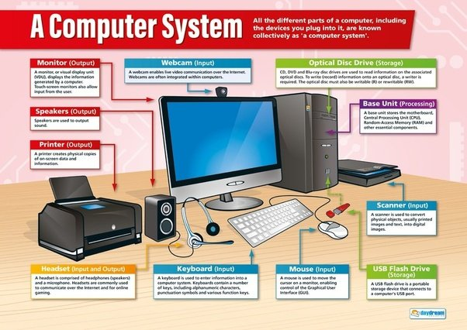
Overview of Computer Systems
History of computer system
Core Components of computers
Generation of computers
Von Neumann Architecture
Software Engineering
Hardware Engineering
Types of Computer Memory
Computer Software
Data Communication

Slide 3
Brief History of Computers System
Chapter summary
History of computers
Development of computers

Slide 4
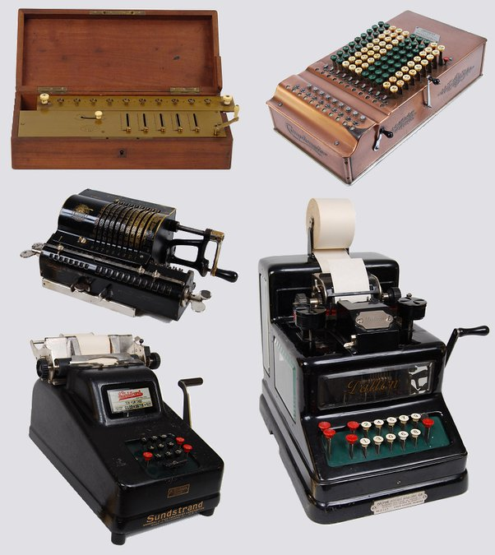
Brief History of Computers System
Key developments of computer systems
Abacus – calculating device (3000 BC)
Pascaline – mechanical adding machine (1642)
Babbage – analytical engine (1830s)
Ada – first programmer (1800s)
Punched cards – data storage (1800s)
Hollerith – tabulating machine (1890s)
Mark I – general purpose computer (1944)

Slide 5
Brief History of Computers System
Pascaline – developed by Blaise Pascal, desktop mechanical adding machine
Analytical engine – invented by Charles Babbage (father of computer)
Ada – world’s first computer programmer
Punched cards – first used by Joseph Jacquard
tabulating machine – invented by Herman Hollerith
Mark I – invented by Dr. Howard Aiken. It’s a programmable, general purpose computer
First electronic computer – Atanasoff-Berry Computer (ABC)

Slide 6
The Parts of a Computer System
A computer can be identified as a device that takes raw data (unprocessed data) and processes it and provides useful information.
It has the ability to store data
The computer consists of main four components:
Hardware
Software
Firmware
users

Slide 7
Generations of computers
First generation (1951 – 1958)
Used vacuum tubes for internal operations
Used low-Level languages for programming (machine language)
Used magnetic drums for primary memory.
Primary memory was limited.
Heat and maintenance problems were there.
Used punch cards for input and outputs.
Input and output was slow.
e.g. UNIVAC I, EDVAC

Slide 8
Generations of computers
Third generation (1965 – 1970)
Used (ICs) on silicon chips for internal operations.
Memory capacity was increased.
Minicomputers became a common use.
Software industry emerged.
Reduction in size and cost of computers happened.
Increase in speed and reliability.
E.g. HONEY WELL-6000 SERIES

Slide 9
Generations of computers
Fourth generation (1971 – today)
Used Large Scale Integration (LSI) and Very Large Scale Integration (VLSI) for internal operations.
Development of the microprocessor happened.
Introductions of micro and super computers.
Increase in speed, power and storage capacity.
Parallel processing was introduced.
Artificial intelligence and expert systems were introduced.
Robotics was introduced.
Increased use of Micro/Personal Computers.
E.g. Apple II, IBM PC Micro Computers

Slide 10
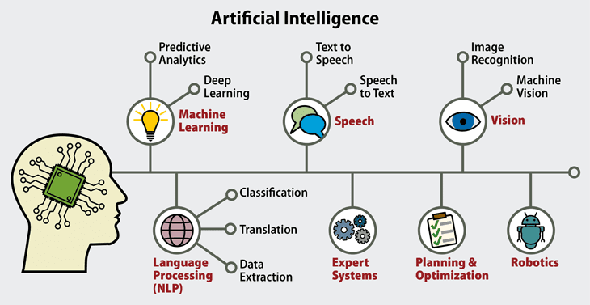
Generations of computers
Fifth generation
A project to develop intelligent computers.
They are computers with artificial intelligence.
Symbolic manipulation and symbolic reasoning is required

Slide 11
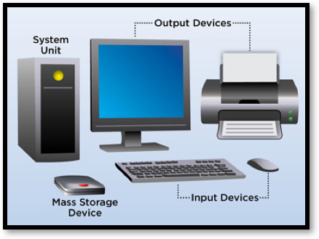
Parts of the computer
There are four main devices in a computer system
Input devices
Output devices
Processor, memory and integrating devices
Storage devices

Slide 12
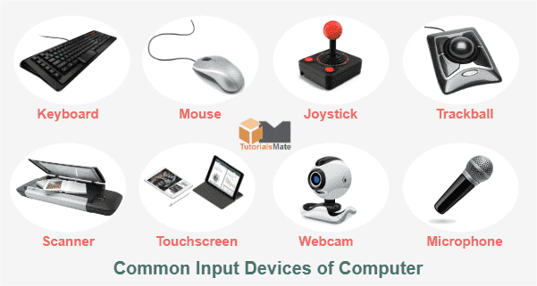
Input Devices
Helps the user to command instructions to the processor
Examples:
keyboard
Mouse, trackball
Joystick
Microphone
Scanner
Digital camera
Barcode Reader
Touch Screen

Slide 13
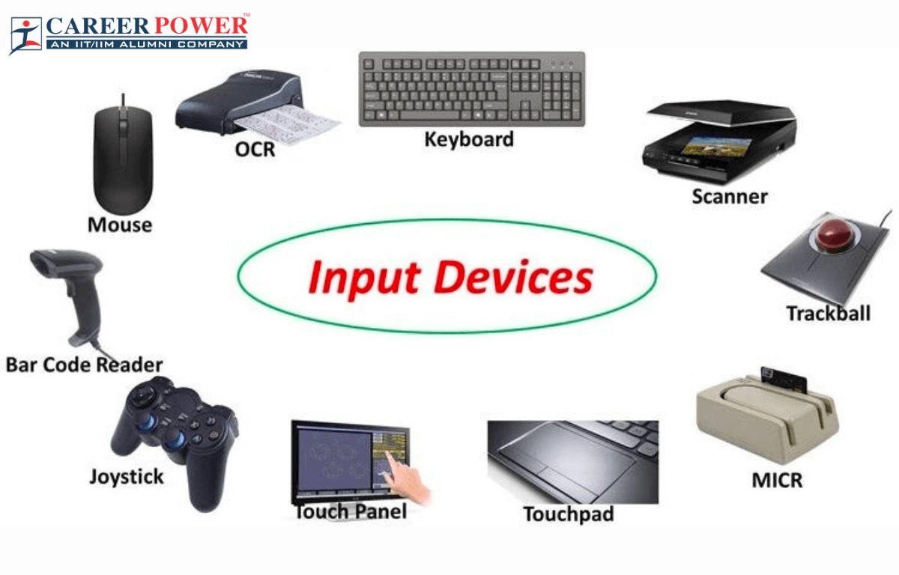
Input Devices
Input devices
Keyboard
Pointer devices (Mouse, track-ball)
Joystick and game pads
Scanner
Microphones, still digital cameras and video cameras

Slide 14
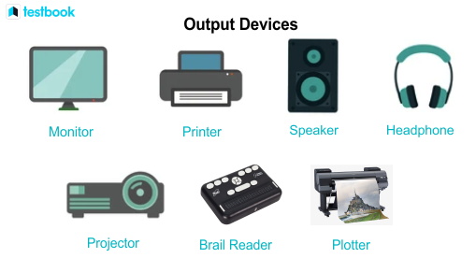
Output Devices
Used to output information to the user.
Example:
Speaker
LCD Panel
Monitor
Projectors
Printer
Plotter
Both Input and output devices – Feedback joystick, touchscreen display

Slide 15
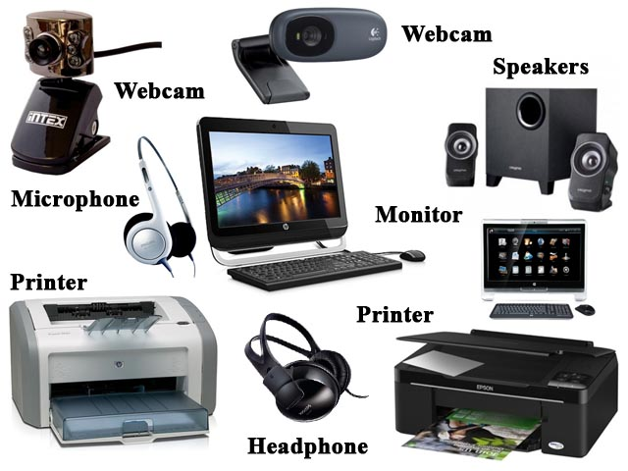
Output Devices
Output devices
Monitor and LCD panel
Printers
Speakers
plotters

Slide 16
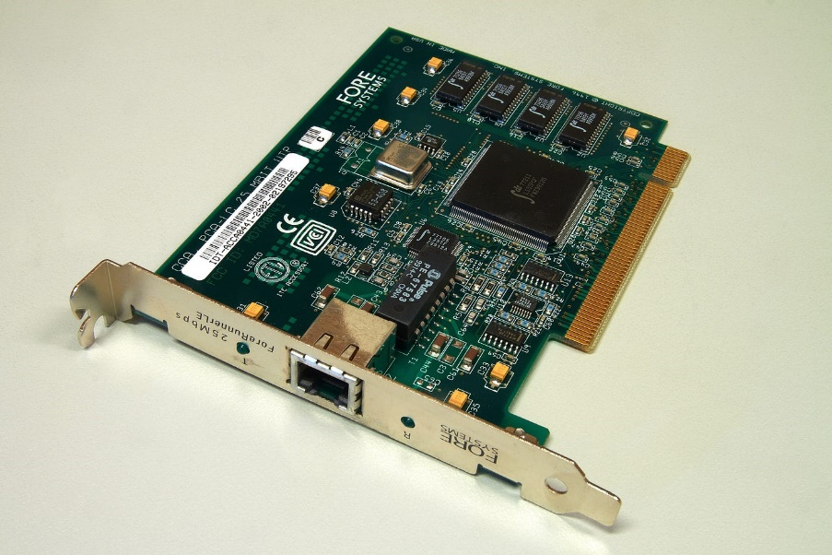
Ports and Expansion cards
Motherboard – cannot function the computer systems without a motherboard.
Video graphics adapter cards
Sound card
Ethernet card
TV card
Data-Fax modem card
USB card
FireWire card
Hard disk and floppy drive ribbon cables CD/DVD drive analog audio cable, video cable, printer cable, USB cables and FireWire cables

Slide 17
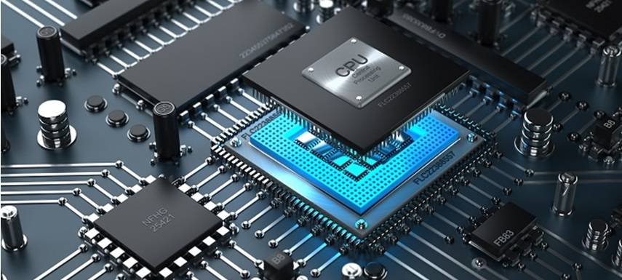
System Unit
Processor, memory and integrating devices
Microprocessor
Motherboard or main board

Slide 18
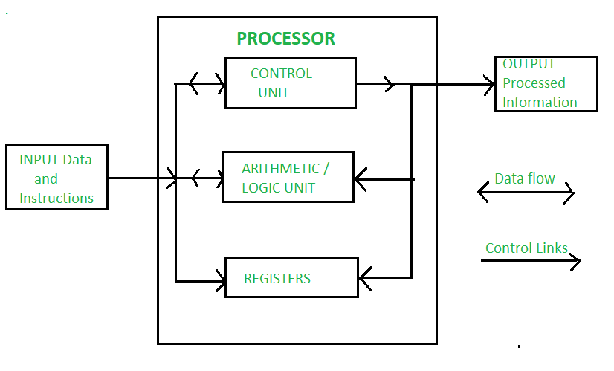
Microprocessor
The processor = human brain
The main difference between the processor from the human brain is that it is dependent on the human and can’t provide information by thinking on its own.
It cannot generate new ideas (not creative)
It is only a device and is conducted through instructions given by the humans.

Slide 19
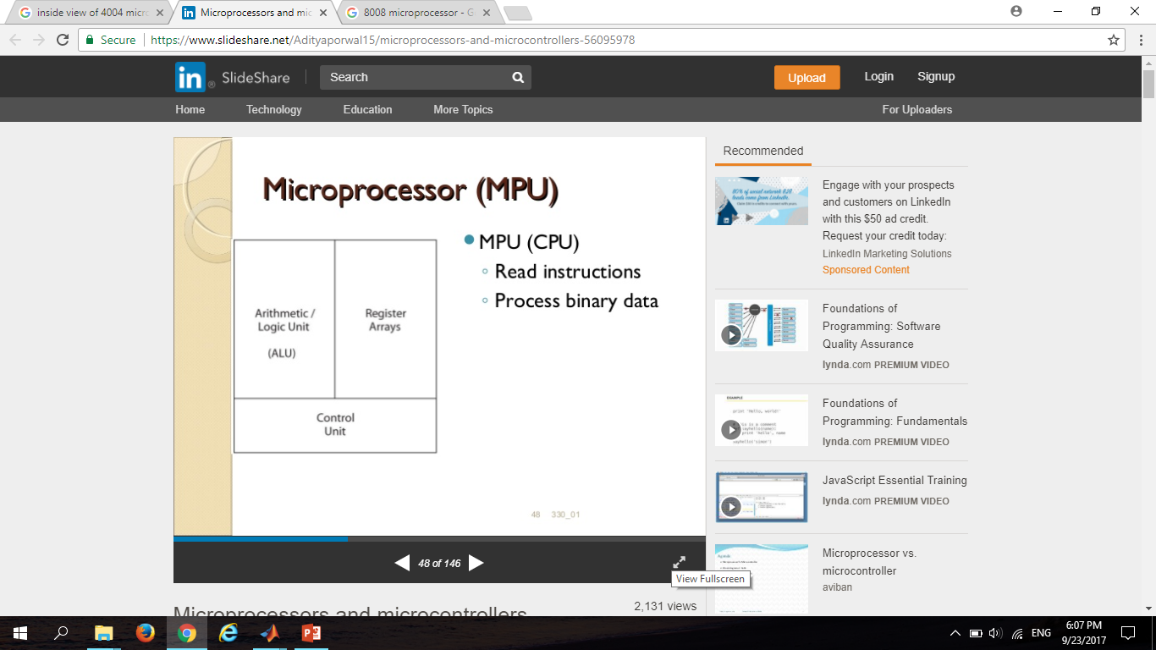
Microprocessor
A microprocessor is a silicon chip that contains a CPU which is used by a computer to do its work.
The word comes from the combination micro and processor.
Read Instructions
Process Binary Data

Slide 20
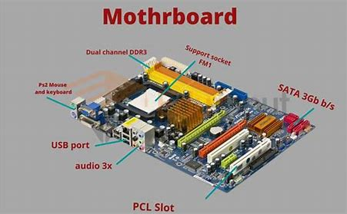
Motherboard
A motherboard is a circuit board which is fixed inside the Central Processing Unit (CPU) of a computer. It can be considered as a computing system which integrates most of the essential components of a computer.

Slide 21
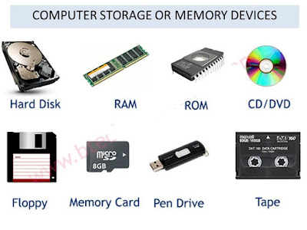
Storage Devices
Storage devices
Hard drives
Compact Disk
DVD and CD ROM
Tape drives
Usb Flash Drives
Flash disks and memory cards
Floppy disks

Slide 22
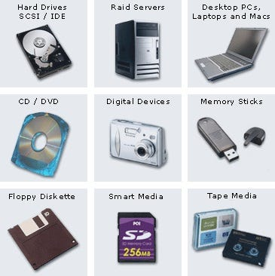
Storage devices
There should be a facility to store data permanently not temporally. For that there’s special storage devices.
Magnetic tape was the earliest forms of data storage device but the access for data is sequential making it more disadvantageous.
Hard disk and floppy disk are randomly accessed storage devices. (magnetic storage devices)
Hard disk – not portable, fixed in a computer
Floppy disks – portable but very limited storage capacity
ZIP disk – can store over 100 megabytes.

Slide 23
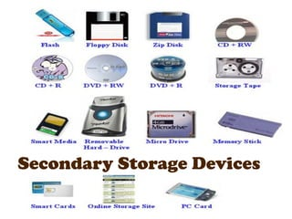
Storage devices
Optical storage devices – CD ROM, DVD ROM
Easy to transport, cost effective
CD ROM – can store around 700 megabytes
DVD ROM – can store in excess of 4.2 gigabytes
Blue ray – can store up to 26 gigabytes
With the technology, flash-drive (pen drive), SD card, compact-flash, Sony memory stick and XD picture-card have emerged.

Slide 24
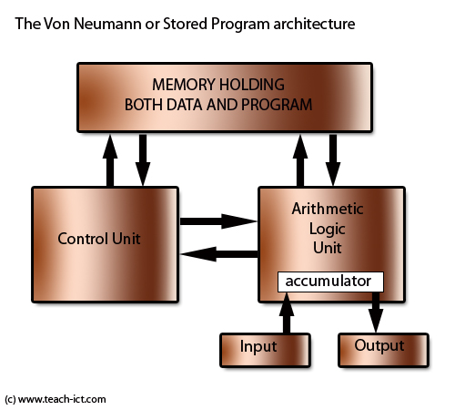
Von Neumann Architecture
Hungarian-American mathematician
wrote "The First Draft of a Report on the EDVAC”, 1945
The first written description of how an electronic computer (a machine for performing calculations automatically)should store programs and processes information.
This architecture is comprised of an Arithmetic Logic Unit (ALU), Control unit, Memory, and Input/output.
This design is still in use in one form or another today in all computers and many electronic devices.

Slide 25
Von Neumann Architecture
Arithmetic Logic Unit
Carrying out the calculation upon the data
All the usual add, multiply, divide and subtract calculations will be available but also data comparison such as “Greater than”, “less than”, “Equal to” will be available
Control Unit
The control unit will manage the process of moving data and program into and out of memory and also deal with carrying out (executing program instructions)- one at a time.
This includes the idea of registers to hold immediate values.

Slide 26
Von Neumann Architecture
Bus
This implies the information should flow between various parts of the computer. In a modern computer built to the von Neumann architecture , information passes back and forth along a “bus”.
“Control Bus” carries signals/commands from the CPU
There are buses to identify locations in memory called “Address bus”
There are buses to allow the flow of data and program instructions called a “Data bus”
Input-Output
This architecture allows for the idea that a person needs to interact with the machine. Whatever values are passed to and forth are stored once again in some internal registers
Registers
Registers refer to high-speed storage areas in the CPU. The data processed by the CPU are fetched from the registers.

Slide 27
Memory Unit
A memory unit is a collection of storage cells together with associated circuits needed to transfer information in and out of the storage.
There are two types of memory
Random access memory (RAM)
Read only memory (ROM)
RAM = store temporary data, can read and write info, data is lost when the power is switched off on the computer (volatile memory), faster access
ROM = read only, non volatile memory (doesn’t loose the data when the computer is switched off), BIOS ROM, CMOS (Complementary Metal Oxide Semiconductor)

Slide 28
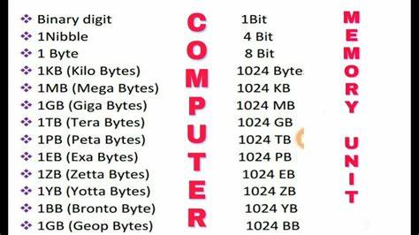
Memory Terminology

Slide 29
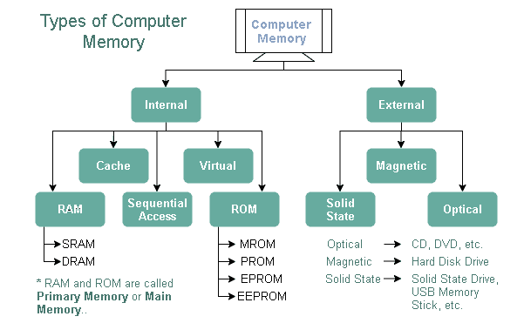
Memory Types

Slide 30
Software Engineering
The software is a collection of integrated programs.
Software subsists of carefully-organized instructions and code written by developers on any of various particular computer languages.
Computer programs and related documentation such as requirements, design models and user manuals.
Engineering is the application of scientific and practical knowledge to invent, design, build, maintain, and improve frameworks, processes, etc.

Slide 31
Types
Software Engineering
Application Development
Embedded Software Engineering
System Software Engineering
Game Software Engineering
Enterprise Software Engineering

Slide 32
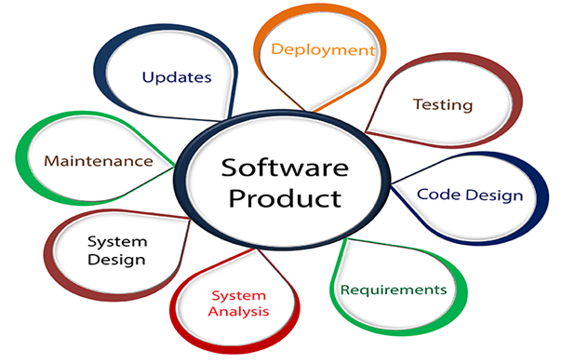
Software Engineering

Slide 33
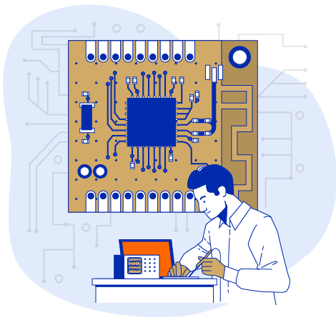
Hardware Engineering

Slide 34
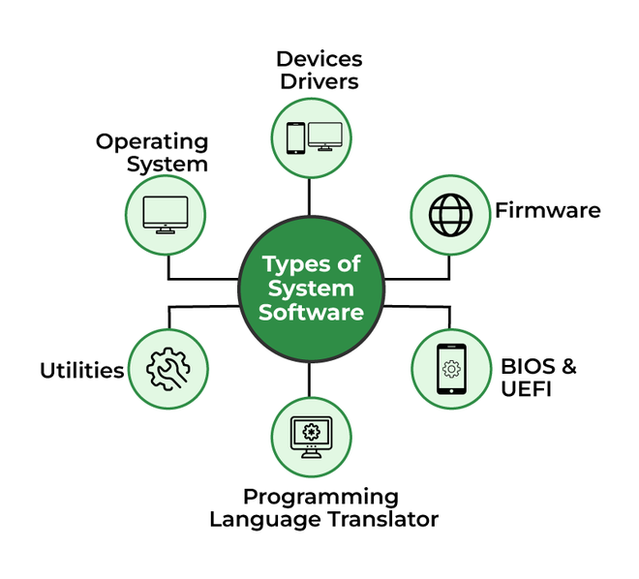
System Software

Slide 35
Operating System
An operating system (OS) is the core software that manages your computer's hardware and software resources. It serves as an intermediary between you, the user, and your device, to coordinate tasks like running programs and handling files.
An operating system enables you to interact with your personal computer, providing a user-friendly interface while efficiently managing system operations to make your device function smoothly and securely.
Process Management
Memory Management
File system management
Device management
User interface
Task Scheduling
Security and access control
Networking

Slide 36
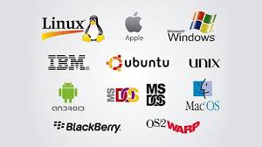
Operating System

Slide 37
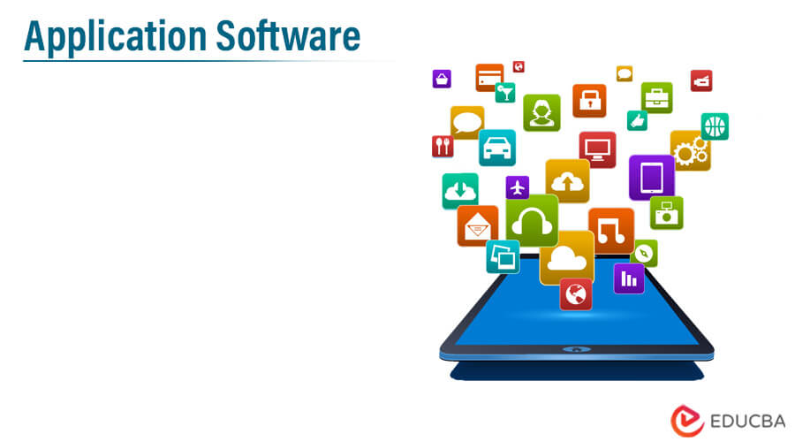
Application Software
Application software is a program or group of programs designed to help users perform specific tasks.
Microsoft Word - A word processing program used for creating and editing documents.
Adobe Photoshop - An image editing software used for photo manipulation and graphic design.
Google Chrome - A web browser for accessing the internet.
Microsoft Excel - A spreadsheet program used for data analysis and visualization.
Zoom - A video conferencing application for virtual meetings.

Slide 38

Programming Languages
Programming languages are algorithms designed for specific performers.
Each programming language has its own command system executed by a computer.
Commands are written in machine language or machine code.
Assembly language is used to convert machine code into symbolic form for easier understanding
High-level programming languages use commands that combine sequences of machine instructions.

Slide 39
Low Level Languages
There are two types of low-level language
Assembly Language
Machine Language
Low-level languages are closer to machine code, like assembly languages.
Machine language commands are written in binary code.
Assembly language is a low-level language that reflects machine code.

Slide 40
High Level Languages
High-level languages are more abstract and easier for humans to understand
High-level programming languages use English-like commands for easier human understanding.
Fortran, Pascal, C++, and Python are examples of high-level programming languages.

Slide 41
Compilers and Interpreters
Compilers translate source code into executable files directly run by the operating system.
Interpreters read and execute code line-by-line or transform code into bytecode.
Languages like Pascal and BC have built-in compilers in their development environments.
Languages like JavaScript, Perl, and Python use interpreters to execute code

Slide 42
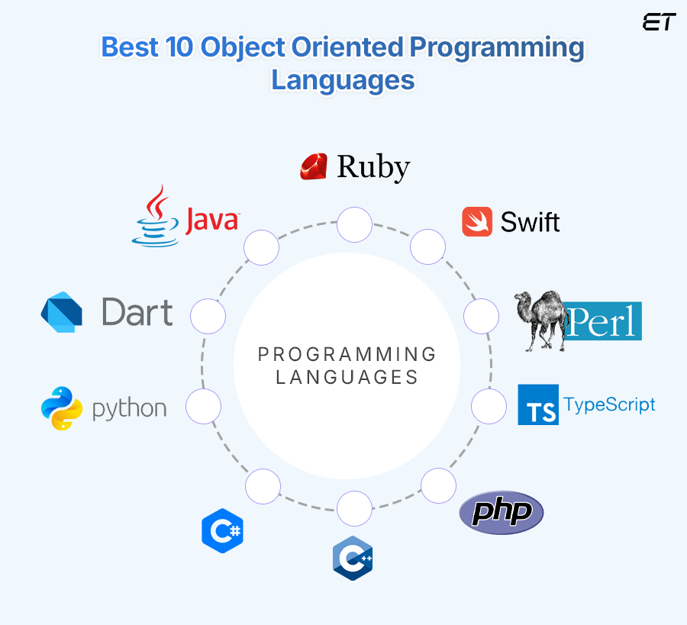
Object Oriented Programming Language
Object-oriented programming (OOP) is a computer programming model that organizes software design around data, or objects, rather than functions and logic. An object can be defined as a data field that has unique attributes and behavior.
Programming languages designed primarily for OOP include the following:
Java.
Python.
C++.

Slide 43
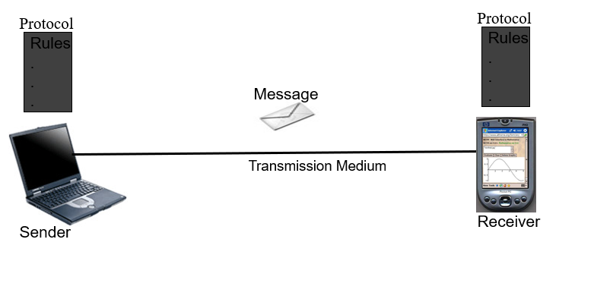
Data Communication
Data Communications are the exchange of data between two devices via some form of transmission.

Slide 44
Data Communication
1. Message: data.
2. Sender: The device that send the message.
3. Receiver: The device that receive the message.
4. Transmission Medium: The physical path between sender and receiver, the message travel.
5. Protocol: Protocol is a set of rules that governs data communication. It represents an agreement between the communicating devices. Without a protocol, two devices may be connected but not communicating.

Slide 45
Data Communication Characteristics
Delivery: The system must deliver data to the correct destination.
Accuracy:
Data delivered accurately.
Altered data which left uncorrected are unusable.
Timelines:
The system must deliver data in timely manner without delay (real-time).

Slide 46
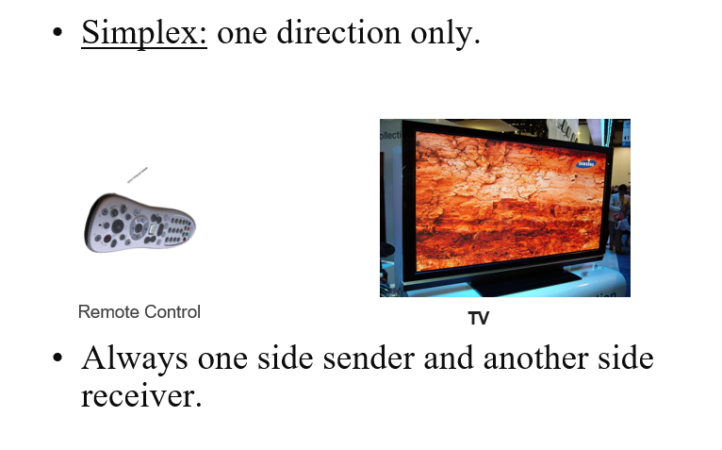
Network Communication Modes

Slide 47
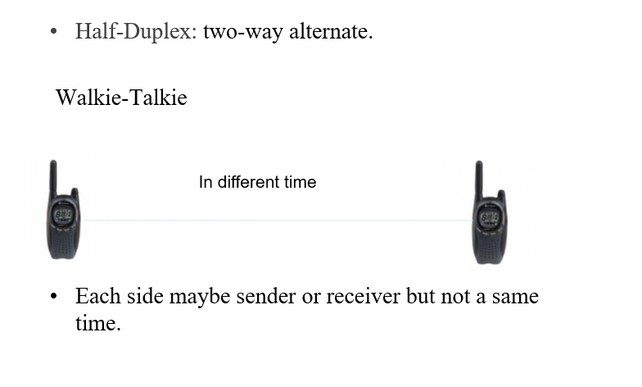
Network Communication Modes

Slide 48
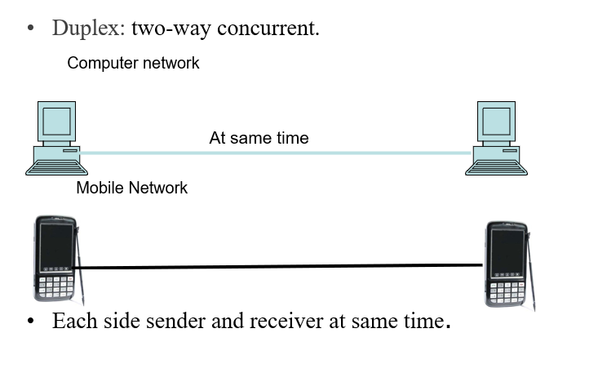
Network Communication Modes

Slide 49
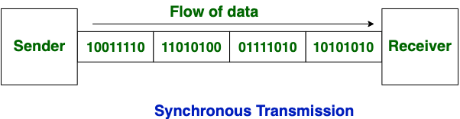
Synchronous Transmission
Synchronous Transmission, data is sent in the form of blocks or frames. This transmission is the full-duplex type.
In Synchronous transmission, There is no time gap present between data.
Both the sender and receiver are synchronized with a common clock signal. This means they operate at the same speed and know exactly when to send and receive data.
Data is sent in a continuous stream

Slide 50
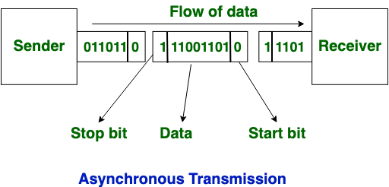
Asynchronous Transmission
In Asynchronous Transmission, data is sent in form of byte or character. This transmission is the half-duplex type transmission.
In this transmission start bits and stop bits are added with data. It does not require synchronization.
Sending individual text messages without knowing exactly when the other person will read them.
The sender and receiver do not share a common clock signal. Instead, data is sent one byte or character at a time, with start and stop bits indicating the beginning and end of each byte.

Slide 51
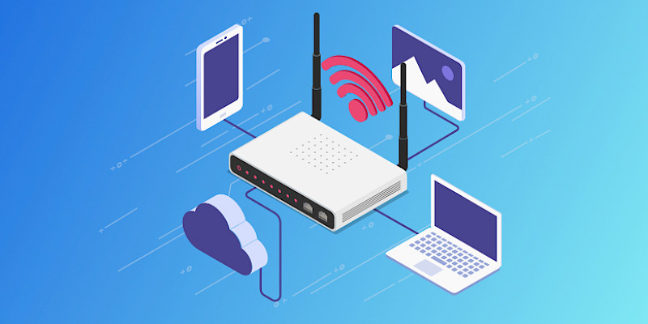
Communication Devices
Routers
A router is a networking device that forwards data packets between computer networks.
It connects different networks (like a home network to the internet) and determines the best path for data to travel from source to destination.
It handles routing between local and wide area networks (LAN/WAN).
Network is segmented by IP address.

Slide 52
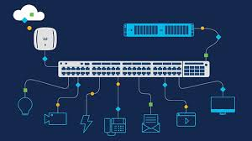
Cont.…
Switches
A switch is a networking device that connects devices within the same network. I
t receives incoming data packets and redirects them to the device on the network that they are intended.
It operates at the data link layer (Layer 2) and efficiently forwards data within the same network based on MAC addresses.
Example: Used in office or home networks to link computers, printers, and other devices together.

Slide 53
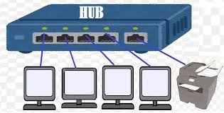
Cont...
Hubs
A hub is a basic networking device that connects multiple devices in a network, but unlike a switch, it doesn't direct data to specific devices.
It broadcasts data to all connected devices.
It operates at the physical layer (Layer 1) and has limited intelligence.
It's less efficient than a switch.
Example: Often replaced by switches in modern networks due to inefficiency

Slide 54
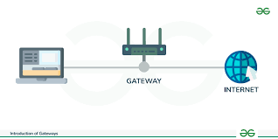
Cont.…
Gateway
A gateway is a device that connects two different networks, often with different protocols.
It acts as a "translator" between different network architectures or communication protocols.
It facilitates communication between different networks, such as between a LAN and the internet.
Example: A gateway is commonly used when connecting a local network to the internet.

Slide 55
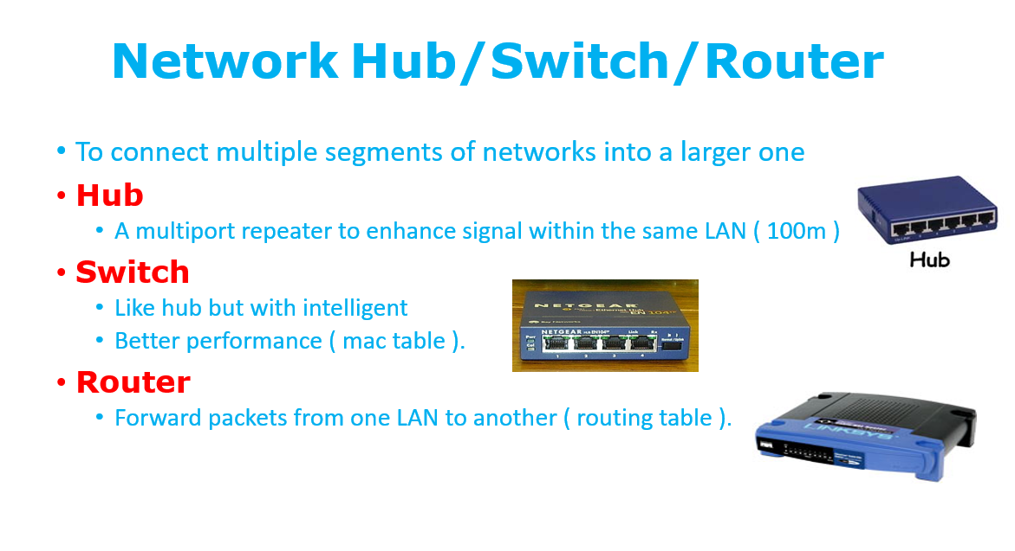
Cont...

Slide 56
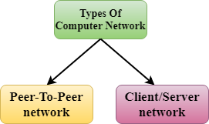
Computer Network Architecture
Computer Network Architecture is defined as the physical and logical design of the software, hardware, protocols, and media of the transmission of data. Simply we can say that how computers are organized and how tasks are allocated to the computer.
The two types of network architectures are used:
Computer Network Architecture
Peer-To-Peer network
Client/Server network

Slide 57
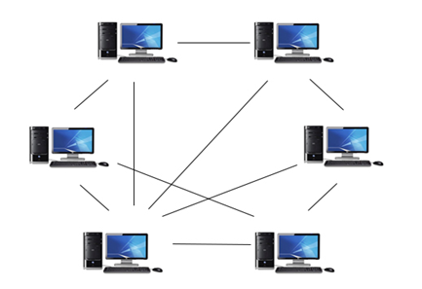
Peer-To-Peer network
Peer-To-Peer network is a network in which all the computers are linked together with equal privilege and responsibilities for processing the data.
Peer-To-Peer network is useful for small environments, usually up to 10 computers.
Peer-To-Peer network has no dedicated server.
Special permissions are assigned to each computer for sharing the resources, but this can lead to a problem if the computer with the resource is down.

Slide 58
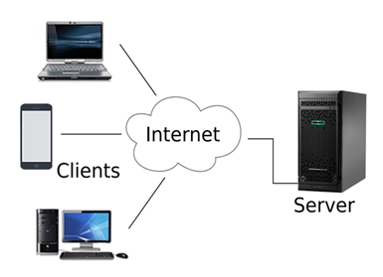
Client/Server network
Client/Server network is a network model designed for the end users called clients, to access the resources such as songs, video, etc. from a central computer known as Server.
The central controller is known as a server while all other computers in the network are called clients.
A server performs all the major operations such as security and network management.
A server is responsible for managing all the resources such as files, directories, printer, etc.

Slide 59
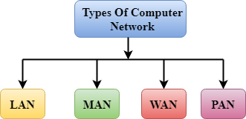
Types of Computer Network
Computer Network
A computer network is a group of computers linked to each other that enables the computer to communicate with another computer and share their resources, data, and applications.
A computer network can be categorized by their size. A computer network is mainly of four types:
Computer Network Types
LAN(Local Area Network)
PAN(Personal Area Network)
MAN(Metropolitan Area Network)
WAN(Wide Area Network)

Slide 60
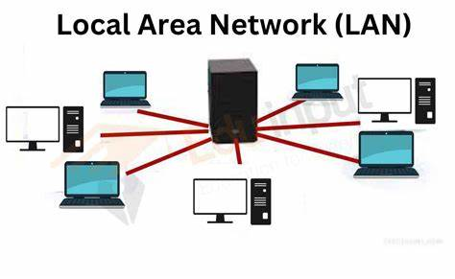
LAN(Local Area Network)
Local Area Network is a group of computers connected to each other in a small area such as building, office.
LAN is used for connecting two or more personal computers through a communication medium such as twisted pair, coaxial cable, etc.
It is less costly as it is built with inexpensive hardware such as hubs, network adapters, and ethernet cables.
The data is transferred at an extremely faster rate in Local Area Network.
Local Area Network provides higher security.

Slide 61
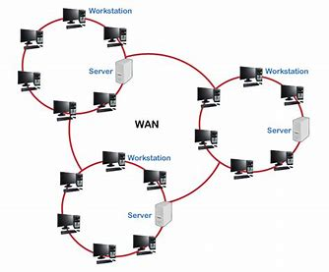
WAN(Wide Area Network)
A Wide Area Network is a network that extends over a large geographical area such as states or countries.
A Wide Area Network is quite bigger network than the LAN.
A Wide Area Network is not limited to a single location, but it spans over a large geographical area through a telephone line, fiber optic cable or satellite links.
The internet is one of the biggest WAN in the world.
A Wide Area Network is widely used in the field of Business, government, and education

Slide 62
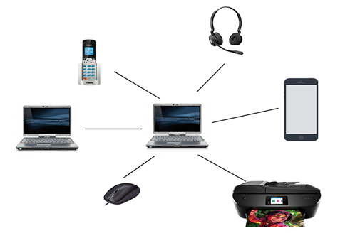
PAN(Personal Area Network)
Personal Area Network is used for connecting the computer devices of personal use is known as Personal Area Network.
Personal computer devices that are used to develop the personal area network are the laptop, mobile phones, media player and play stations.
Personal Area Network covers an area of 30 feet

Slide 63
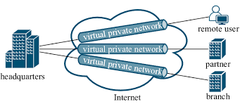
Virtual Private Network
Virtual Private Network
It allows you to connect your computer to a private network, creating an encrypted connection that masks your IP address to securely share data and surf the web, protecting your identity online.
A virtual private network, or VPN, is an encrypted connection over the Internet from a device to a network.
It uses public network such as internet to connect computers.

Slide 64
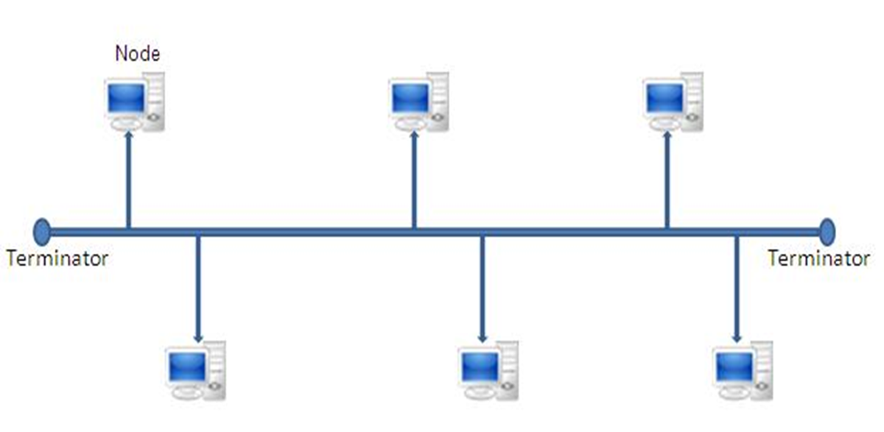
Network Topologies
Bus Topology
This type of network was widely used in the 1980’s
Each computer communicates to other computers on the network independently this is referred to as PEER-TO-PEER networking.
Both ends of the bus must be terminated with a terminating resistor. Terminators stop signals after reaching end of wire to Prevent signal bounce.
Difficult to administer/troubleshoot .
A cable break can disable the entire network; no redundancy.
Performance degrades as additional computers are added.

Slide 65
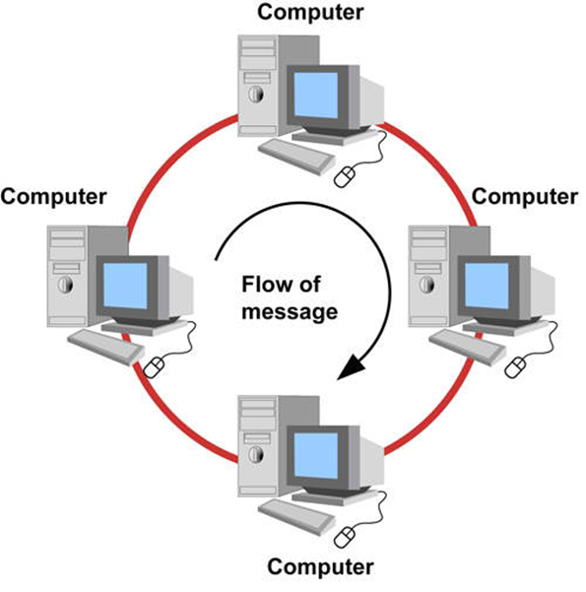
Ring Topology
Ring Topology
In Ring topology each node is connected to the two nearest nodes so the entire network forms a circle.
Data only travels in one direction on a Ring network.
Sending and receiving of data takes place by the help of TOKEN
Token contains a piece of information which along with data is sent by the source computer the recipients NIC address is attached to the message.
This token then passes to next node, which checks if the signal is intended to it.
Performance is better than that of Bus topology.
Each packet of data must pass through all the computers between source and destination, slower than star topology.
If one workstation or port goes down, the entire network gets affected.
Requires more cable and network equipment at the start.

Slide 66
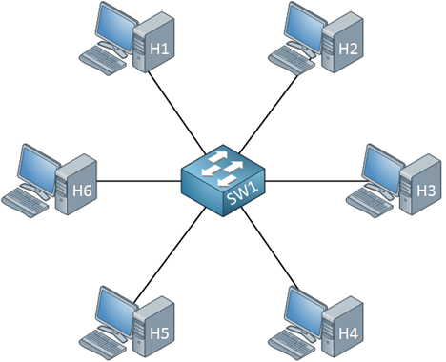
Star Topology
Star Topology
In a Star topology every node is connected through a central device such as a Hub, Switch or Router .
Each port, and the device to which it connects, has its own dedicated bandwidth
Compared to Bus topology it gives far much better performance.
Easy to connect new nodes or devices.
Centralized management. It helps in monitoring the network.
Failure of one node or link doesn’t affect the rest of network.
If central device fails whole network goes down.

Slide 67
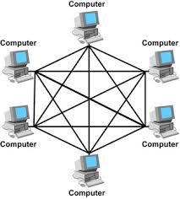
Mesh Topology
Mesh Topology
Mesh topology is a network configuration where devices are connected in a decentralized manner, forming a mesh-like structure.
In a mesh network, each device connects directly to multiple other devices, instead of relying on a central hub or switch
Mesh networks can provide a strong, consistent signal strength over a large area.
Mesh networks can be easy to set up and manage.
Mesh networks can be expensive.
Mesh topology can be complex

Slide 68
Network Protocols
What is a Network Protocol?
A protocol is a set of rules that governs the communications between computers on a network. These rules include guidelines that regulate the following characteristics of a network: access method, allowed physical topologies, types of cabling, and speed of data transfer.
Transmission Control Protocol (TCP)
User Datagram Protocol (UDP)
Hypertext Transfer Protocol (HTTP)
File Transfer Protocol (FTP )

Slide 69
Network Protocols
TCP/IP is the MAIN protocol of the internet. Popular also for intranets using the internet. It is also widely used on many organizational networks due to its flexibility and wide array of functionality provided. Also, it enables computers to exchange data with each other in a meaningful, organized, and efficient way.
HTTP provides a standard for Web browsers and servers to communicate.
HTTP clients (such as Web browsers) and servers communicate via HTTP request and response messages.
FTP allows you to transfer files between two computers on the Internet.
FTP supports two modes of data transfer: plain text (ASCII), and binary
SMTP stands for Simple Mail Transfer Protocol, which is an internet standard that allows mail servers to send and receive emails.

